Slide 1
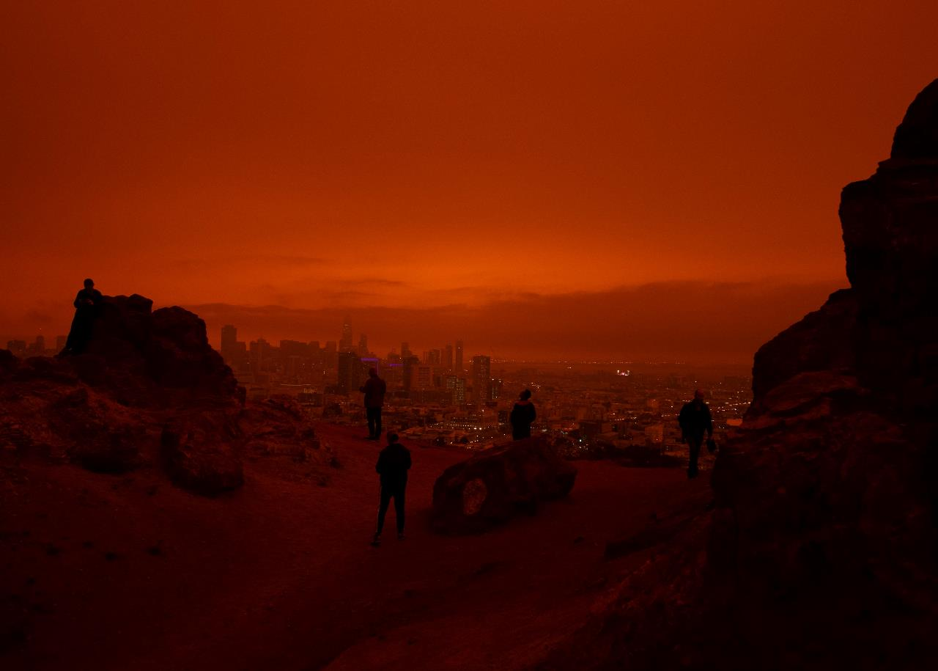
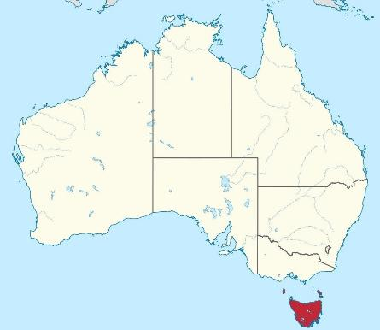
Collapse, Utopia, and Tasmania:
Escape in the prefigurative futures of climate change
Alexander Luke Burton (Alex)
I acknowledge and pay respect to the traditional custodians of the lands I live and work, the Mumirimina and Muwinina peoples
7-minute presentation for the Social Psychology of the Future mini-conference

Slide 2
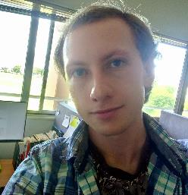
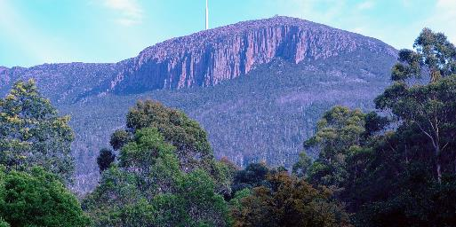
Who am I?
I’m Alex (he/him); Email: Alexander.Burton@utas.edu.au
PhD Candidate at the University of Tasmania; School of Geography, Planning, and Spatial Sciences
Human geography; studying narratives of societal and environmental collapse in Tasmania
PhD Research
Recently completed a literature review of sustainability, collapse, and utopia texts in narrativising the climate change crisis
Question:
How is Tasmania imagined as a site of escape from socio-environmental collapse?
How do narratives of sustainability and utopia inside Tasmania relate to these imaginings?
How do narratives of sustainability and utopia outside/about Tasmania relate to these imaginings?

Slide 3
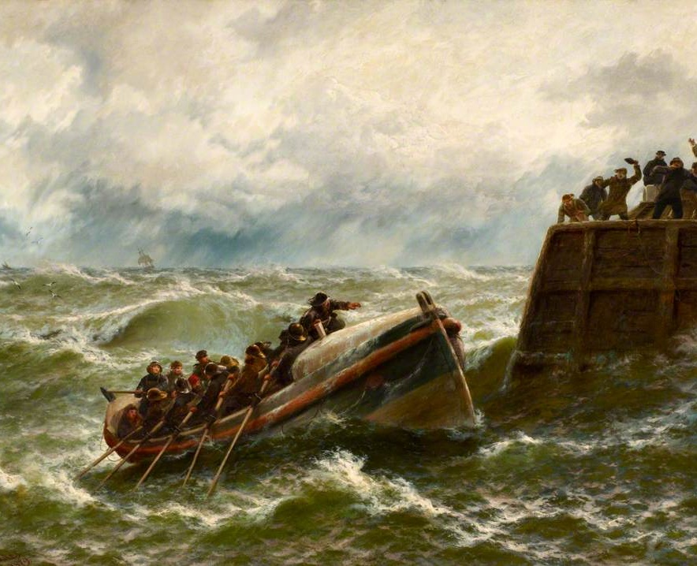
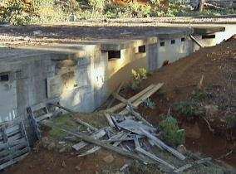
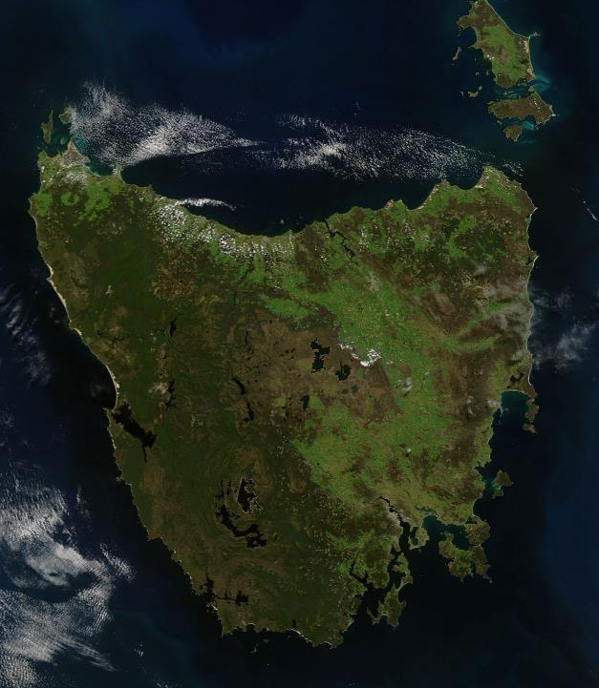
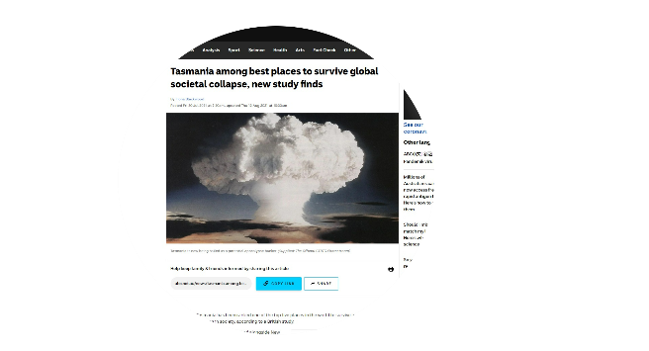
Tasmania as a site of escape
Fig. 1
Tasmania is an island-state in Australia
King and Jones (2021) simplistically refer to it as a ‘lifeboat’ for socio-environmental collapse
The island has a legacy of romanticised marginality
Including its colonial-convict settlement in the 19th century
Has a collapse-utopia history including (Alexander 2018):
Genocide of Tasmanian Aboriginals
Intentional communities ‘communes’
‘Sea change’ movement
Doomsday preppers (Fig. 1 Martin Polin’s bunker)
Tourism marketing

Slide 4
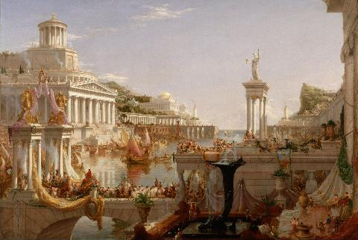
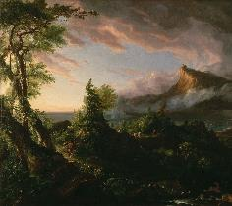
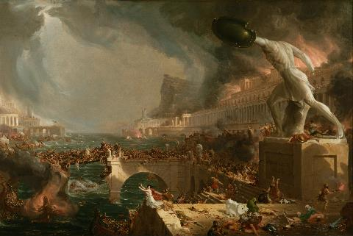
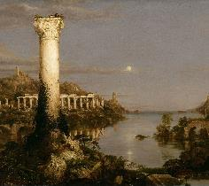
The Utopia-Collapse Cycle: Whose prefigurative futures?
Fig. 2
How utopia and collapse are imagined and defined is influenced by, and influences, the performance of the future
Social collapse is sometimes imagined as cyclical in Western discourses, while environmental collapse is imagined as linear
Temporal imaginaries matter (Bluedorn & Standifer 2006)
Complicating Western temporal imaginaries reveals how climate change can be simultaneously prefigurative and already present (Servigne & Stevens 2020)
Fig. 3
Fig. 6
Figures: 1. The Arcadian State; 2. The Consummation; 3. Destruction; 4. Desolation; 5. The Savage State; The Course of Empire by Thomas Cole, painted from 1833-1836.
Fig. 5
Fig. 4

Slide 5
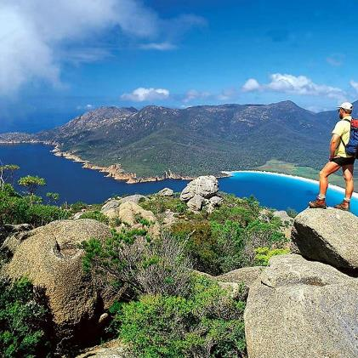
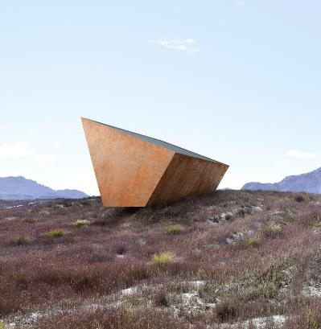
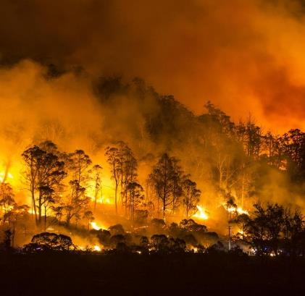
Tasmania in the prefigurative futures of climate change
Fig. 7
Fig. 8
Fig. 9
Futures are experientially and temporally uneven (Williams 2011)
Escape is imagined in different ways
Tasmania as a beautiful destination for a holiday to escape life’s pressures (Figure 7)
‘Earth’s Black Box’, built on Tasmania’s remote west coast, imagines Tasmania as a distant location to observe global societal collapse (Figure 8)
Tasmania’s fire season becoming longer and more severe as a present-day impact of climate change. You can’t escape a global problem (Figure 9)

Slide 6
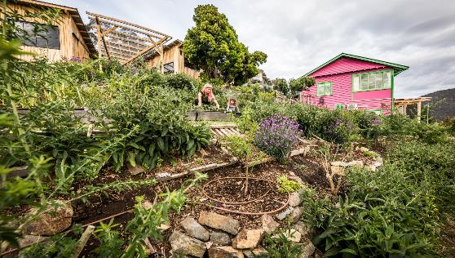
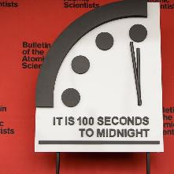
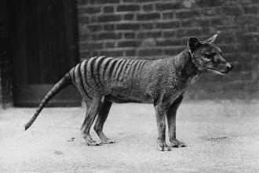
Summary / Q&A
Collapse and utopia are recursively involved in temporal imagination
Climate change is both prefigurative and already present. Escape is a privilege
I am studying Tasmania as an example of this complexity. So if you’re interested…
Alexander, A. 2018. Duck and Green Peas Forever! Finding Utopia in Tasmania. Fullers Bookshop.
Blackwood, F. 2021. Tasmania among best places to survive global societal collapse, new study finds. ABC News. 30 July 2021. Available at: https://www.abc.net.au/news/2021-07-30/tasmania-among-best-places-to-survive-global-collapse/100333892.
Bluedorn, A.C. & Standifer, R.L. 2006. Time and the temporal imagination. Academy of Management Learning & Education. Vol. 5, No. 2, pp. 196-206. https://www.jstor.org/stable/40214366.
Cole, T. 1833-1836. The Course of Empire. Series of Paintings. New-York Historical Society: New York.
Kilvert, N. 2021. Earth is getting a black box to record our climate change actions, and it's already started listening. ABC News. Available at: https://www.abc.net.au/news/science/2021-12-06/climate-change-earth-black-box-recorder/100621778.
King, N. Jones, A. 2021. ‘An Analysis of the Potential for the Formation of ‘Nodes of Persisting Complexity’’. Sustainability. Vol. 13, No. 8161. 1-32. https://doi.org/10.3390/su13158161.
Servigne, P. and Stevens, R. 2020. How Everything Can Collapse: A Manual for Our Times. UK: Polity Press.
Williams, E.C. 2011. Combined and Uneven Apocalypse: Luciferian Marxism. UK: Winchester: Zero Books.
Contact: ResearchGate: https://www.researchgate.net/profile/Alexander-Burton-2
Twitter: @AlexBurtonline
Email: Alexander.Burton@utas.edu.au

